Slide 1
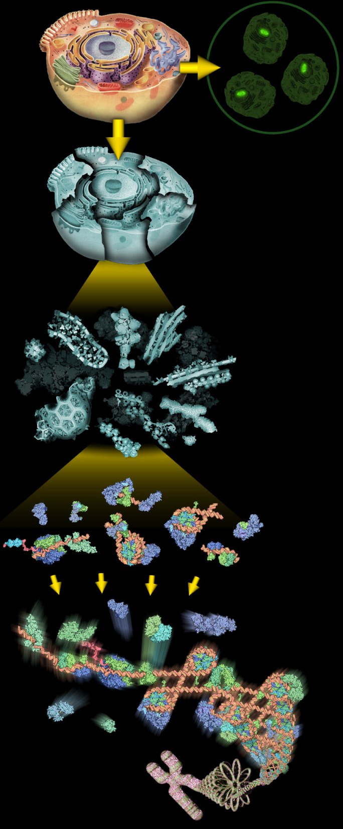
Proteomics Informatics Workshop
Part III: Protein Quantitation
David Fenyö
February 25, 2011
Metabolic labeling – SILAC
Chemical labeling
Label-free quantitation
Spectrum counting
Stoichiometry
Protein processing and degradation
Biomarker discovery and verification

Slide 2
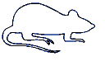
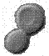
Proteomics Informatics
Biological System
Experimental
Design
Samples
Sample
Preparation
MS/MS
MS
Measurements
Data Analysis
What does the
sample contain?
How much?
What does the
sample contain?
How much?
Information about each sample
Information
Integration
Information about the biological system

Slide 3
Proteomic Bioinformatics – Quantitation
Sample i
Protein j
Peptide k
Lysis
Fractionation
Digestion
MS
LC-MS

Slide 4
Quantitation – Label-Free (Standard Curve)
Sample i
Protein j
Peptide k
Lysis
Fractionation
Digestion
LC-MS
MS

Slide 5
Quantitation – Label-Free (MS)
Sample i
Protein j
Peptide k
Lysis
Assumption:
constant for all samples
Fractionation
Digestion
LC-MS
MS
MS

Slide 6
Quantitation – Metabolic Labeling
Light
Heavy
Lysis
Assumption: All losses after mixing are identical for the heavy and light isotopes and
Fractionation
Digestion
LC-MS
Sample i
Protein j
Peptide k
MS
L
H
Oda et al. PNAS 96 (1999) 6591
Ong et al. MCP 1 (2002) 376

Slide 7
Comparison of metabolic labeling
and label-free quantitation
Metabolic
Label free assumption:
constant for all samples
Metabolic labeling assumption:
constant for all samples and the behavior of heavy and light isotopes is identical
G. Zhang et al., JPR 8 (2008) 1285-1292

Slide 8
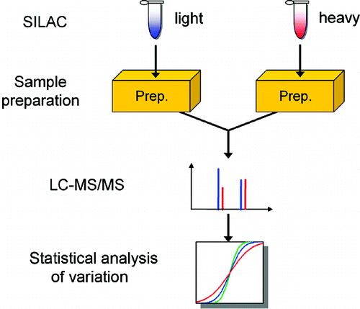
Intensity variation between runs
Replicates
1 IP
1 Fractionation
1 Digestion
vs
3 IP
3 Fractionations
1 Digestion
G. Zhang et al., JPR 8 (2008) 1285-1292

Slide 9
How significant is a measured change in amount?
Metabolic
It depends on the size of the random variation of the amount measurement that can be obtained by repeat measurement of identical samples.

Slide 10
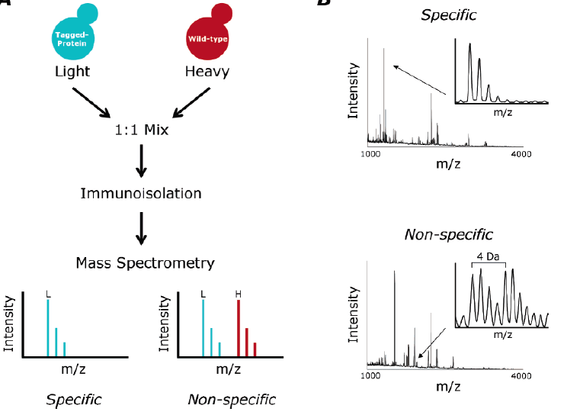
Protein Complexes – specific/non-specific binding
Tackett et al. JPR 2005

Slide 11
Protein Turnover
Heavy
Move heavy
labeled cells to
light medium
Newly produced
proteins will have
light label
Light
K_{C}=log(2)/t_{C}, t_{C} is the average time it takes for cells to go through the cell cycle, and K_{T}=log(2)/t_{T}, t_{T} is the time it takes for half the proteins to turn over.

Slide 12
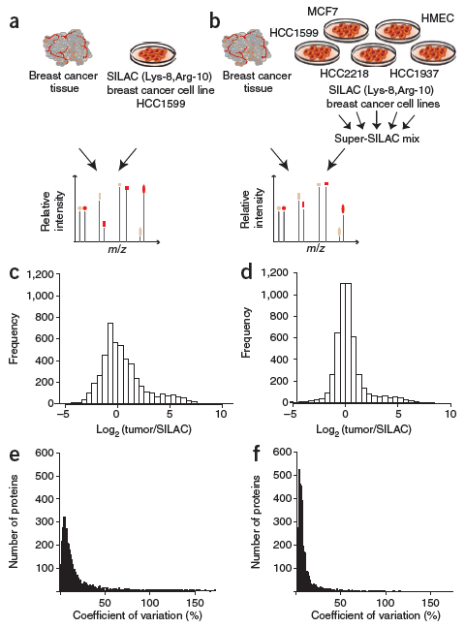
Super-SILAC
Geiger et al., Nature Methods 2010

Slide 13
Quantitation – Protein Labeling
Assumption: All losses after mixing are identical for the heavy and light isotopes and
Lysis
Light
Heavy
Fractionation
Digestion
LC-MS
MS
L
H
Gygi et al. Nature Biotech 17 (1999) 994

Slide 14
Quantitation – Labeled Proteins
Recombinant
Proteins (Heavy)
Lysis
Assumption: All losses after mixing are identical for the heavy and light isotopes and
Light
Fractionation
Digestion
LC-MS
MS
L
H

Slide 15
Quantitation – Labeled Chimeric Proteins
Recombinant
Chimeric
Proteins (Heavy)
Lysis
Fractionation
Light
Digestion
LC-MS
MS
L
H
Beynon et al. Nature Methods 2 (2005) 587
Anderson & Hunter MCP 5 (2006) 573

Slide 16
Quantitation – Peptide Labeling
Assumption: All losses after mixing are identical for the heavy and light isotopes and
Lysis
Fractionation
Digestion
Light
Heavy
LC-MS
MS
L
H
Gygi et al. Nature Biotech 17 (1999) 994
Mirgorodskaya et al. RCMS 14 (2000) 1226

Slide 17
Quantitation – Labeled Synthetic Peptides
Assumption: All losses after mixing are identical for the heavy and light isotopes and
Lysis
Fractionation
Digestion
Synthetic
Peptides
(Heavy)
Light
Enrichment with
Peptide antibody
LC-MS
Anderson, N.L., et al.
Proteomics 3 (2004) 235-44
MS
L
H
Gerber et al. PNAS 100 (2003) 6940

Slide 18
Quantitation – Label-Free (MS/MS)
Lysis
Fractionation
Digestion
LC-MS
SRM/MRM
MS/MS
MS
MS
MS/MS

Slide 19
Quantitation – Labeled Synthetic Peptides
Light
Lysis/Fractionation
Synthetic
Peptides
(Heavy)
Digestion
Synthetic
Peptides
(Heavy)
LC-MS
MS
MS
L
H
L
H
L
MS/MS
H
MS/MS
L
MS/MS
H
MS/MS

Slide 20
Quantitation – Isobaric Peptide Labeling
Lysis
Fractionation
Digestion
Light
Heavy
LC-MS
MS
MS/MS
H
L
Ross et al. MCP 3 (2004) 1154

Slide 22
Isotope distributions
Intensity
m/z
m/z
m/z

Slide 23
Peak Finding
Intensity
Find maxima of
m/z
The signal in a peak can be
estimated with the RMSD
and the signal-to-noise ratio of a peak
can be estimated by dividing the signal
with the RMSD of the background

Slide 24
Background subtraction
Intensity
m/z

Slide 25
Estimating peptide quantity
Peak height
Peak height
Curve fitting
Curve fitting
Intensity
Peak area
m/z

Slide 26
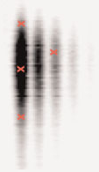
Time dimension
Intensity
m/z
Time
Time
m/z

Slide 27
Sampling
Intensity
Retention Time

Slide 28
Sampling
5%
5%
Acquisition time = 0.05σ

Slide 29
Sampling

Slide 30
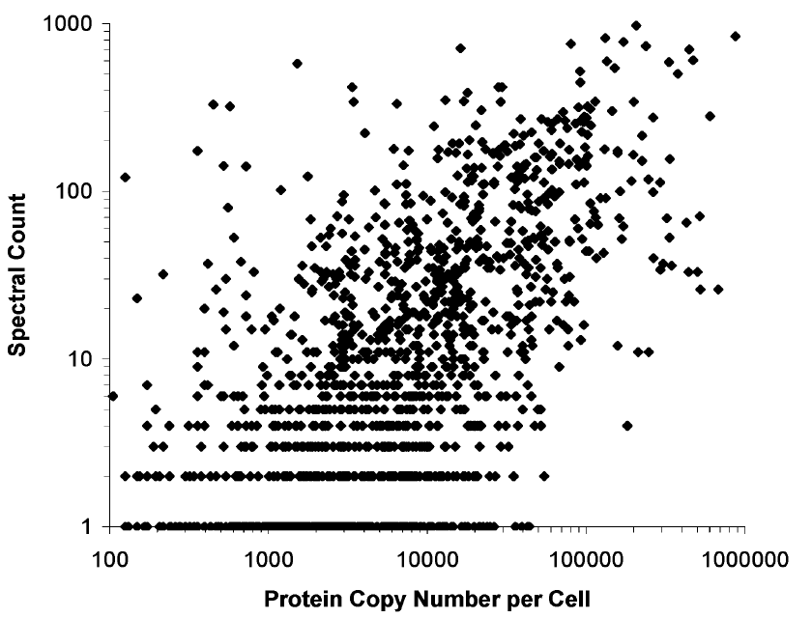
Estimating peptide quantity by spectrum counting
Time
m/z
Liu et al., Anal. Chem. 2004, 76, 4193

Slide 31
What is the best way to estimate quantity?
Peak height - resistant to interference
- poor statistics
Peak area - better statistics
- more sensitive to interference
Curve fitting - better statistics
- needs to know the peak shape
- slow
Spectrum counting - resistant to interference
- easy to implement
- poor statistics for
low-abundance proteins

Slide 32
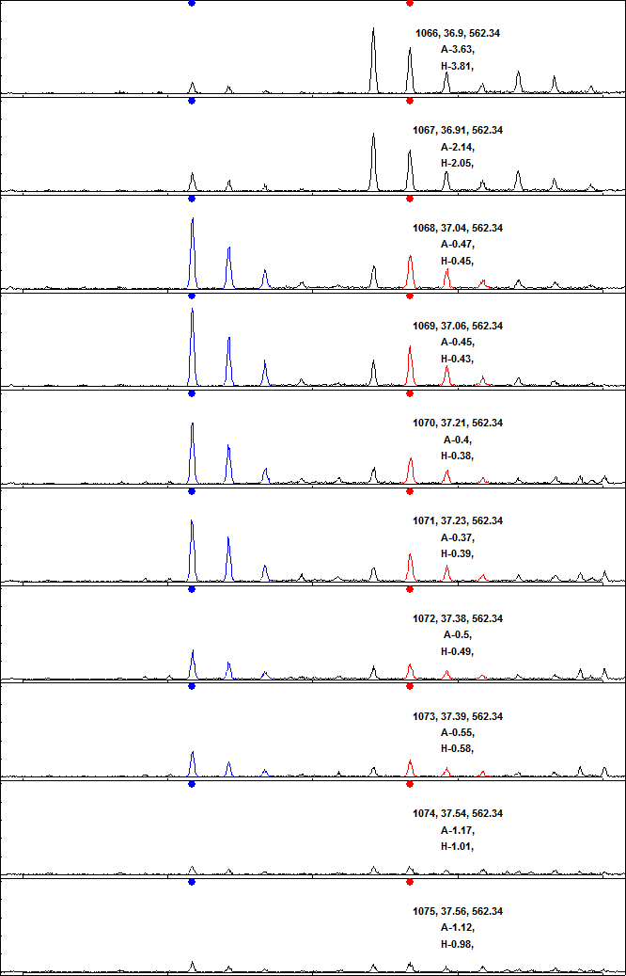
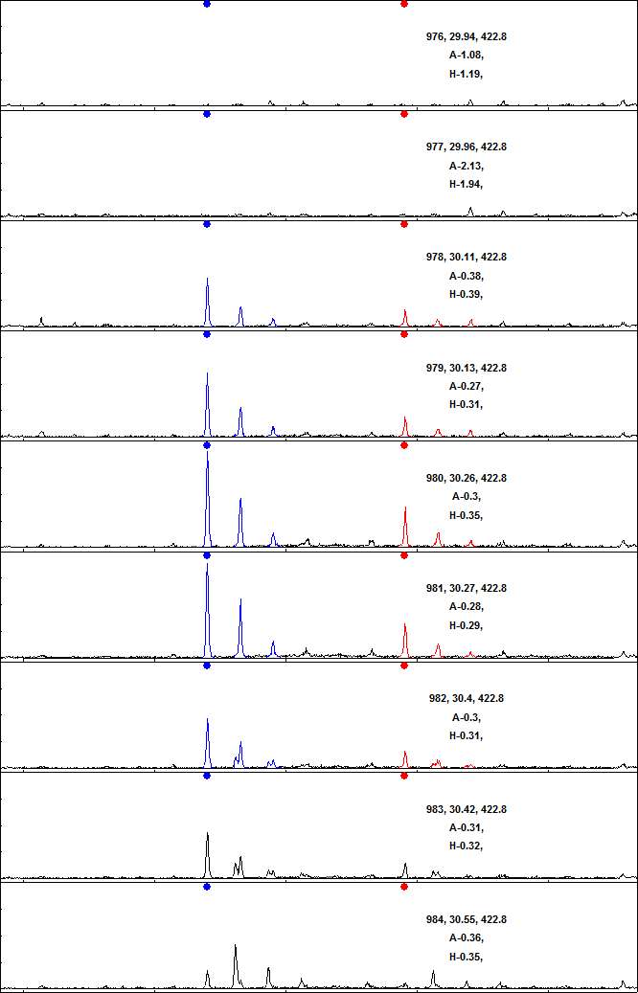
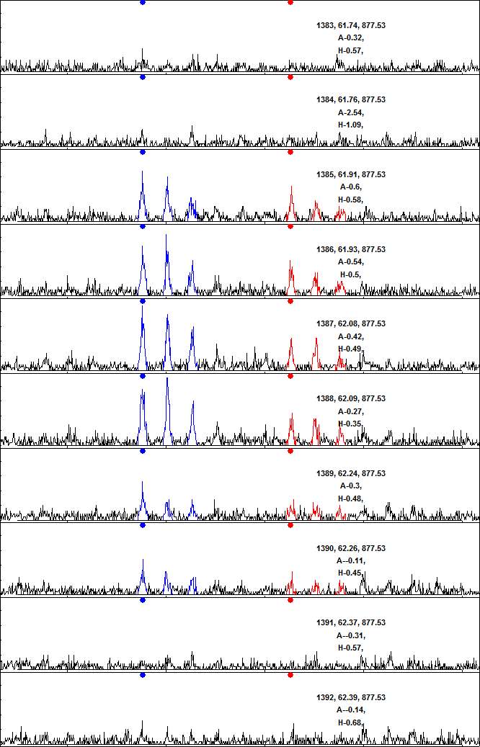
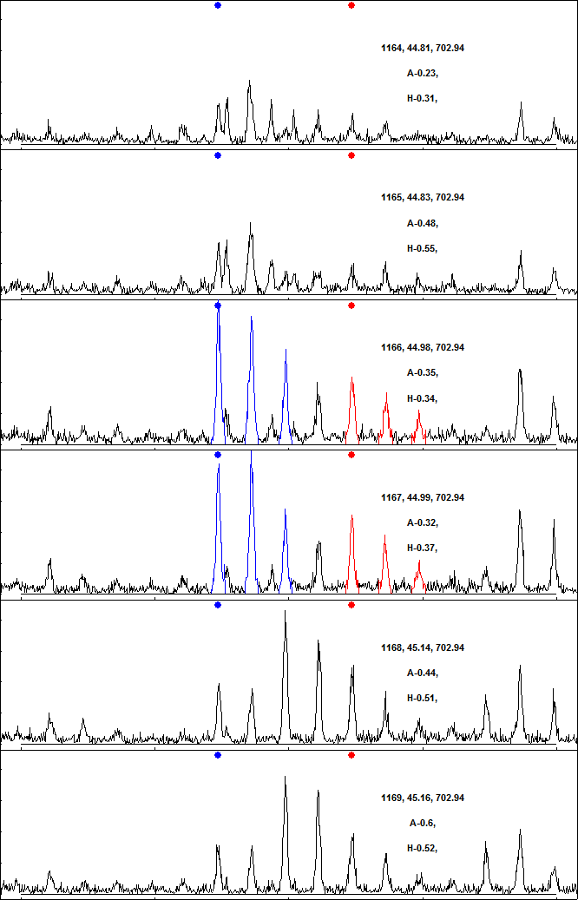
Examples - qTOF

Slide 33
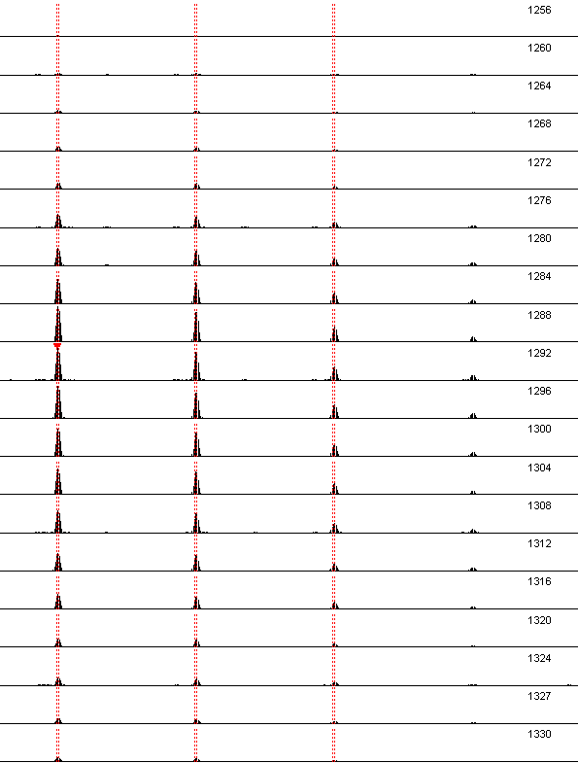
Examples - Orbitrap

Slide 34
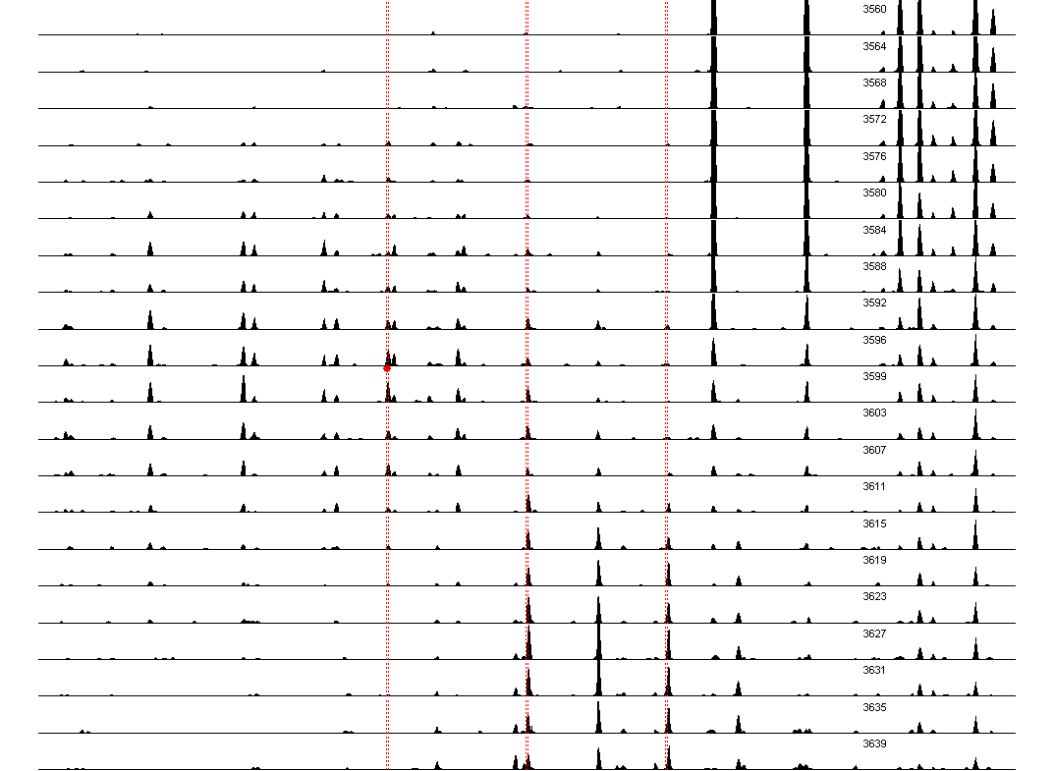
Examples - Orbitrap

Slide 35
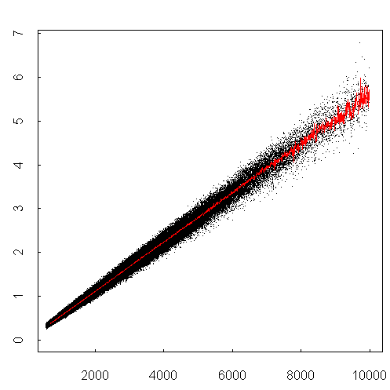
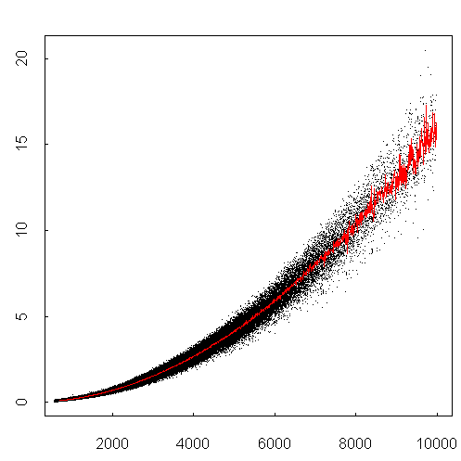
Isotope distributions
Intensity ratio
Intensity ratio
Peptide mass
Peptide mass

Slide 36
AADDTWEPFASGK
Intensity
Intensity
Intensity
Time

Slide 37
AADDTWEPFASGK
Intensity
Intensity
Intensity
2
Ratio
1
0
2
Ratio
1
0
Time

Slide 38
AADDTWEPFASGK
Intensity
Intensity
Intensity
G
m/z
H
m/z
I
m/z

Slide 39
YVLTQPPSVSVAPGQTAR
Intensity
Intensity
Intensity
Time

Slide 40
YVLTQPPSVSVAPGQTAR
Intensity
Intensity
Intensity
2
Ratio
1
0
2
Ratio
1
0
Time

Slide 41
YVLTQPPSVSVAPGQTAR
Intensity
Intensity
Intensity
m/z
m/z
m/z

Slide 42
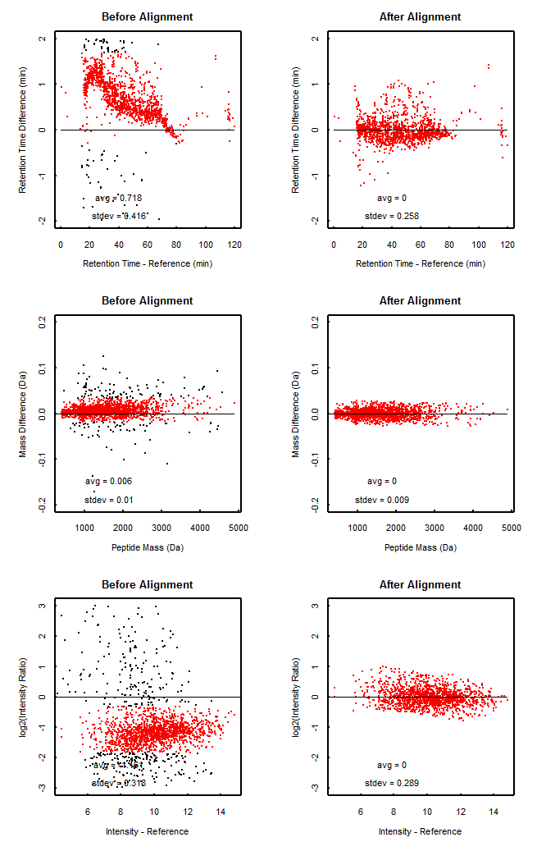
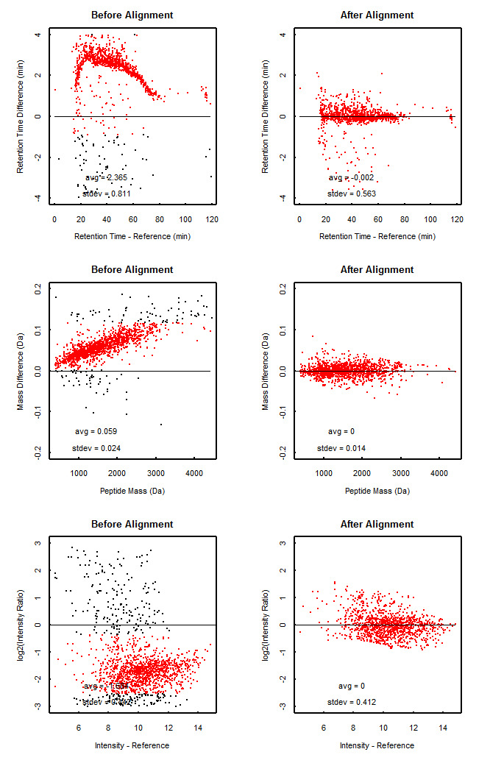
Retention Time Alignment

Slide 43
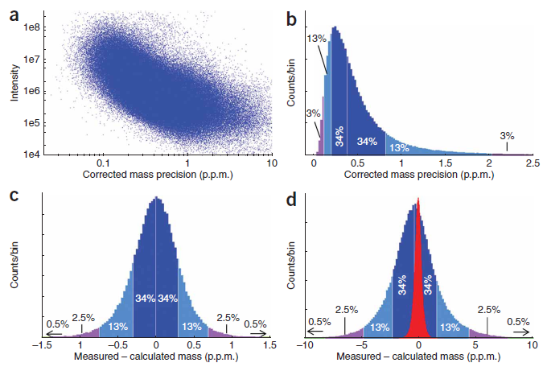
Mass Calibration
Cox & Mann, Nat. Biotech. 2008

Slide 44
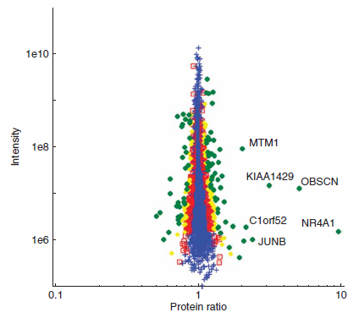
The accuracy of quantitation is
dependent on the signal strength
Cox & Mann, Nat. Biotech. 2008

Slide 45
Workflow for quantitation with LC-MS
Standardization
Retention time alignment
Mass calibration
Intensity normalization
Quality Control
Detection of problems with
samples and analysis
Quantitation
Peak detection
Background subtraction
Limits for integration in time and mass
Exclusion of interfering peaks

Slide 46
Biomarker discovery
Lysis
Fractionation
Digestion
LC-MS
MS
MS

Slide 47
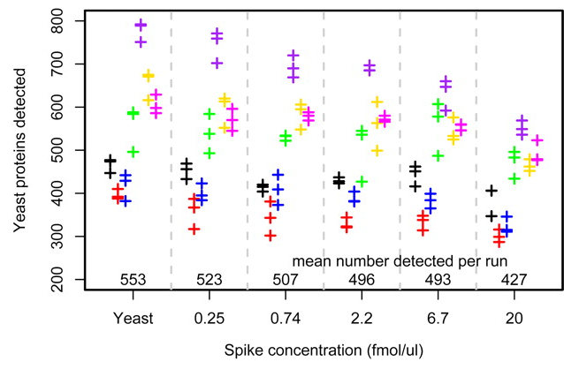
Reproducibility
Paulovich et al., MCP 2010

Slide 48
Biomarker verification
Light
Lysis/Fractionation
Synthetic
Peptides
(Heavy)
Digestion
Synthetic
Peptides
(Heavy)
LC-MS
MS
MS
L
H
L
H
L
MS/MS
H
MS/MS
L
MS/MS
H
MS/MS

Slide 49
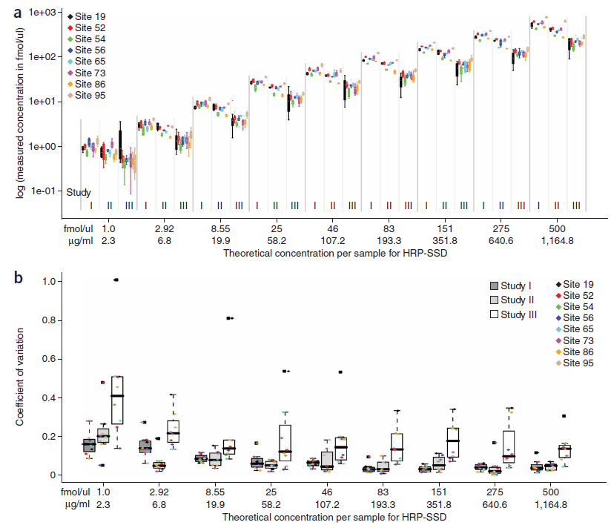
Reproducibility
CPTAC
Verification
Work Group
Study 7
10 peptides
3 transitions
per peptide
Conc. 1-500 fmol/μl
Human plasma
Background
8 laboratories
4 repeat analyses
per lab
Addona et al., Nat. Biotech. 2009

Slide 50
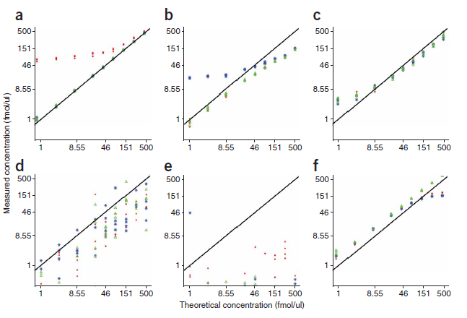
Reproducibility
Addona et al., Nat. Biotech. 2009

Slide 51
Correction for interference
MRM analysis of low abundance proteins is sensitive to interference from other components of the sample that have the same precursor and fragment masses as the transitions that are monitored.
During development of MRM assays, care is usually taken to avoid interference, but unanticipated interference can appear when the finished assay is applied to real samples.

Slide 52
Ratios of intensities of transitions
Peptide 1
Peptide 2
Peptide 1
Peptide 2

Slide 53
Detection of interference
Interference is detected by comparing the ratio of the intensity of pairs of transitions with the expected ratio and finding outliers.
Transition i has interference if
where Z_{threshold} is the interference detection threshold;
;
z_{ji} is the number of standard deviations that the ratio between the intensities of transitions j and i deviate from the noise;
I_{i} and I_{j} are the intensities of transitions i and j;
r_{ji} is the expected ratio of the intensity of transitions j and i; and
σ_{ji} is the noise in the ratio.

Slide 54
Correction for interference in experimental data
Peptide 1
Peptide 2

Slide 55
Correction for interference in experimental data
Peptide 1
Peptide 2
Peptide 1
Peptide 2

Slide 56
Proteomics Informatics Workshop
Part I: Protein Identification, February 4, 2011
Part II: Protein Characterization, February 18, 2011
Part III: Protein Quantitation, February 25, 2011

